Slide 1

KUV100 MEDIA LAUNCH
10th April, 2018
Milan

Slide 2
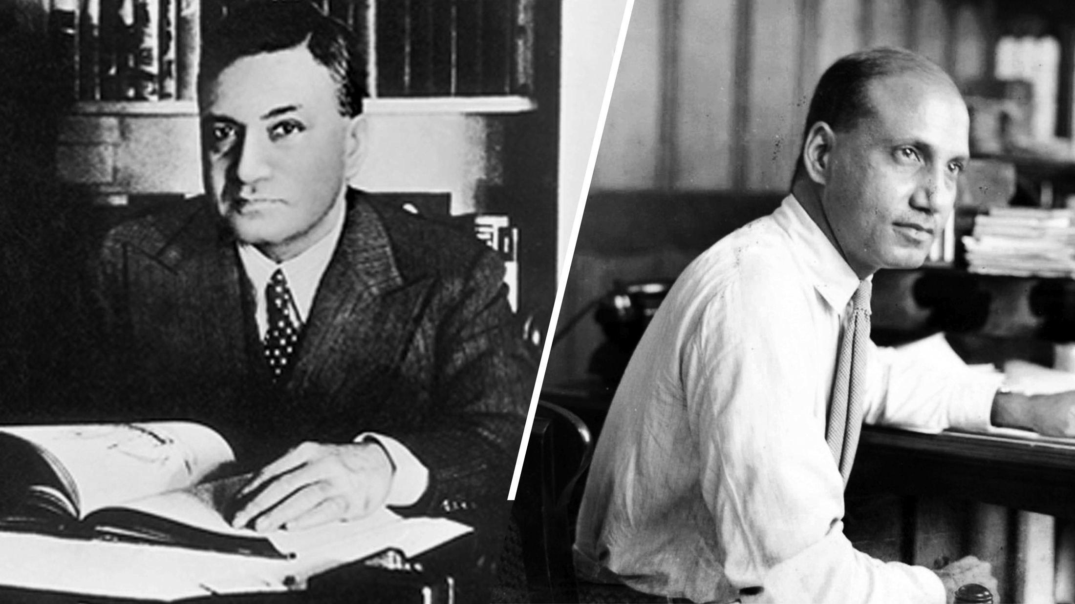
Our story begins in 1945, with two men on a mission.

Slide 3
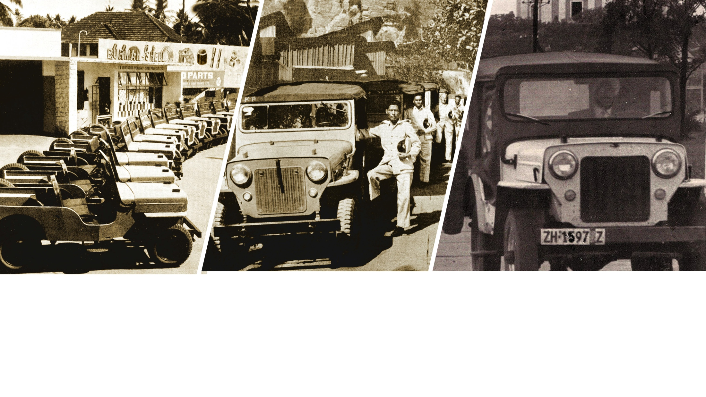
The mission - driven by the core idea that people will succeed if given an opportunity - was to bring the iconic Willlys CJ onto Indian roads.

Slide 4
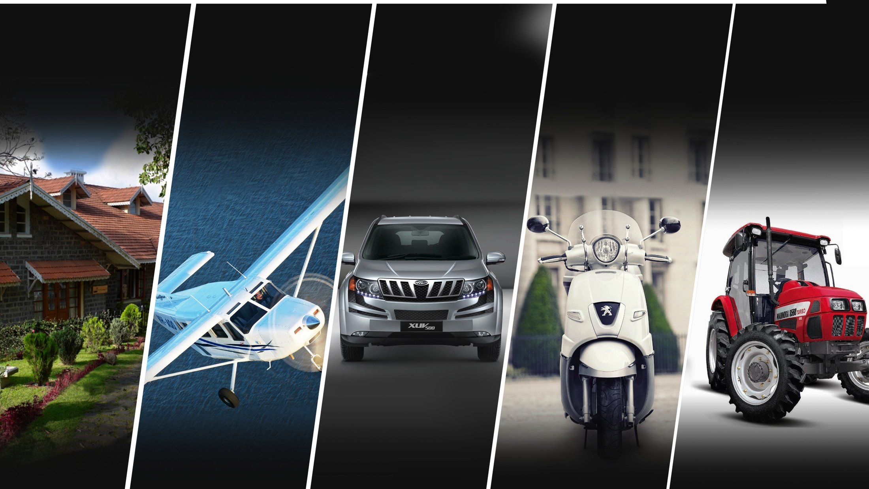
THE MAHINDRA GROUP
Many Companies. One Purpose.

Slide 5
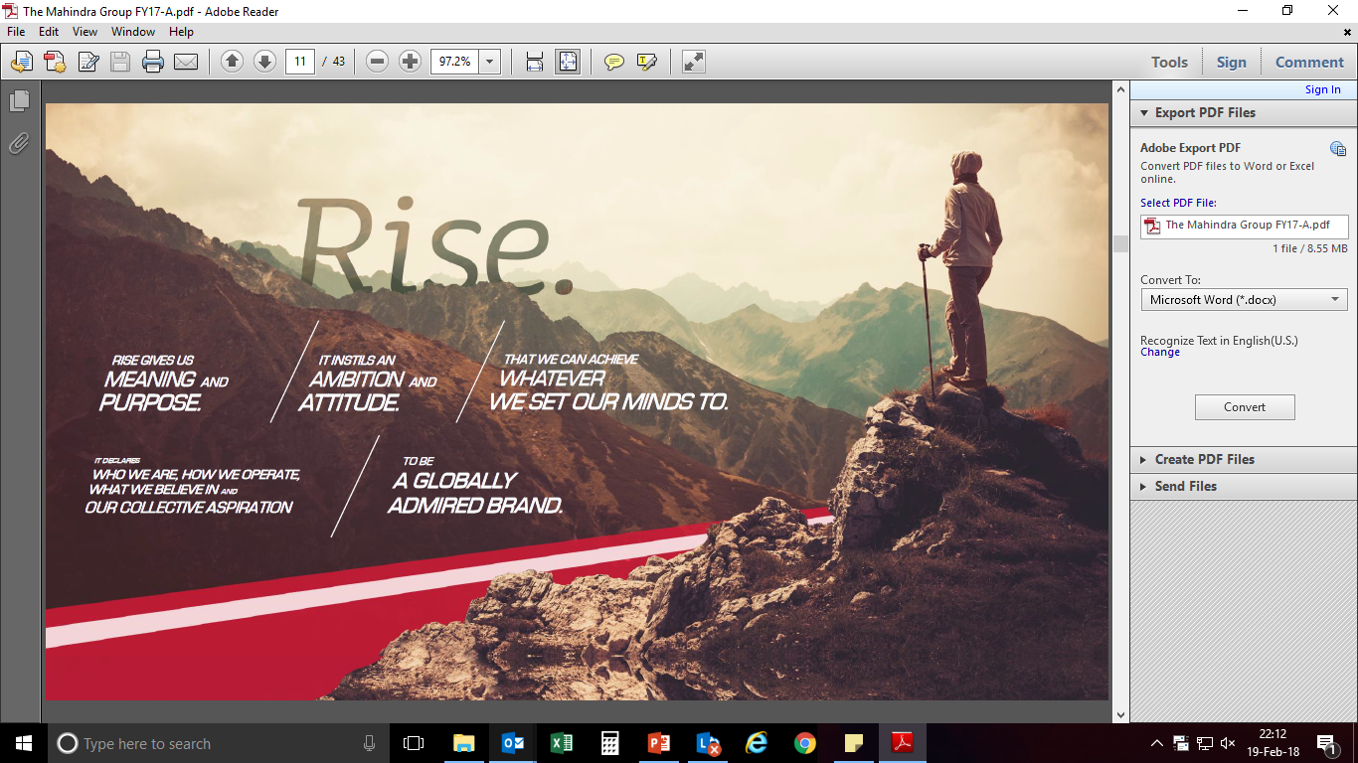
To Enable People To RISE…

Slide 6
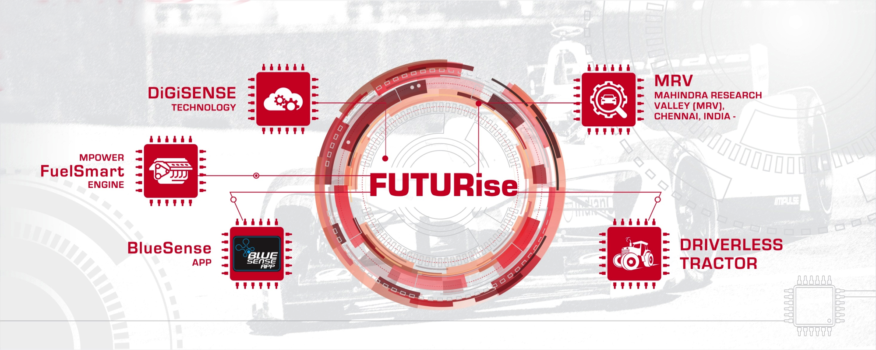
#FUTURise : Focus Areas
Notes:
Smart Shift is a first of its kind load exchange program for Small Commercial Vehicles
Revolutionary connected vehicle technology solution – lets you know about your vehicle health all the time

Slide 7
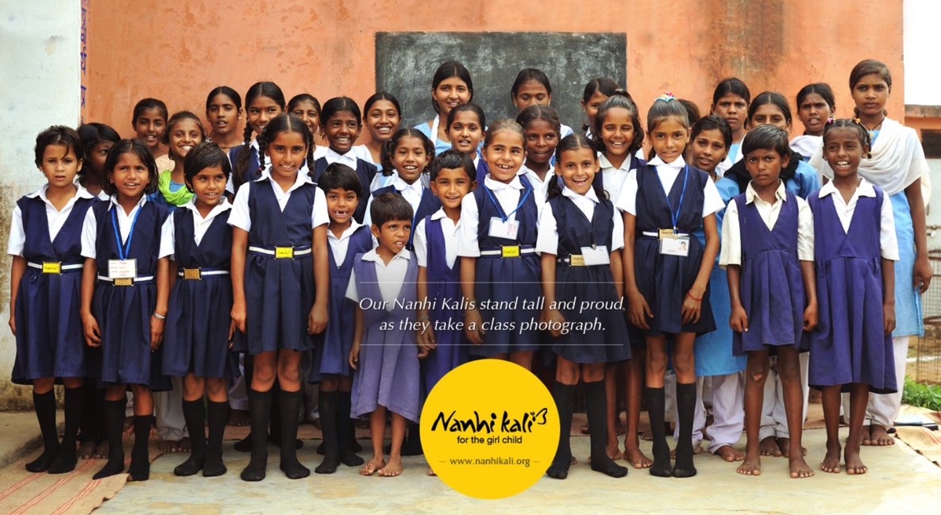
‘Rise For Good’ is the other pillar
Education for the girl child… >300,000 girls supported across India

Slide 8
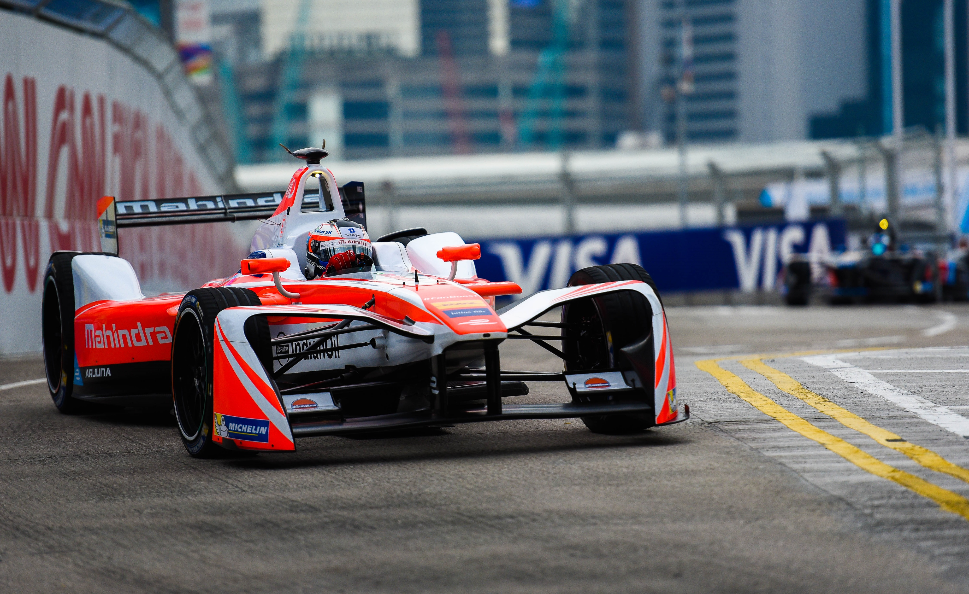

Foray into Formula-E is one of the initiatives

Slide 9


Today Mahindra has…
200,000+ employees
USD 19 BILLION Revenue
(40% from Overseas)
Presence in 100+ COUNTRIES
Across 11 SECTORS

Slide 10
Mahindra Group’s International Footprint
Finland
Sampo Rosenlew
Mahindra Europe
Italy: Pininfarina
Legendary automotive design house
Mahindra Automotive : North America
100+ engineers
Manufacturing
Japan:
Mitsubishi Agricultural Machinery
South Korea:
SsangYong Motor Company
Mahindra USA
Tractor assembly & distribution
Turkey
2 Tractor Plants
India:
15 Manufacturing locations
Mahindra Research Valley
Mahindra South Africa
Mahindra Australia
Notes:
Our presence in every continent is a testimony of the group’s global growth aspirations

Slide 11
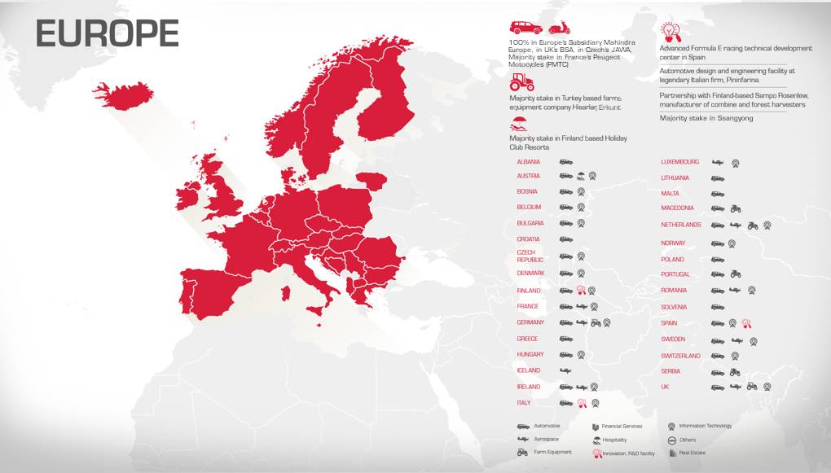

Slide 12
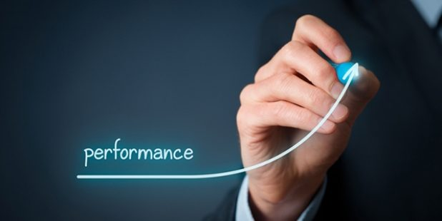
We are here to grow…

